Slide 1

Predict Prices Of Airline Tickets
Dhananjay Phalke - 20104120
Snehi Ratani - 20104035
Disha Phatta - 20104029
Project Guide
Ms. Shital Agarwal

Slide 2
Contents
Introduction
Objectives
Scope
Literature Survey
Proposed System
Project Outcomes
Block Diagram
Use Case
Technology Stack

Slide 3
1. Introduction
Problem Identified :
    Flight ticket prices can be something hard to guess, today we might see a price, check out the predicted price of the same flight tomorrow, and it will be a different story.
Solution Proposed :
    This project aims to develop an website which will predict the flight prices for various flights. The user will get basic idea which will help them to decide book their tickets accordingly.

Slide 4
2. Objectives
To predict future flight price.
To help airlines optimize their pricing strategies.
To enhance customer experience.
To provide travelers with more accurate and reliable information about flight prices.

Slide 5
3. Scope
Can provide a valuable tool for the airline industry.
Can help consumers save money on airfare.
Helps customers to plan there budget of the trips.
Can create opportunities for further research and development in the field of machine learning and data analytics.

Slide 6
4. Literature Survey
"Airfare prediction using machine learning" by Zheng, Liu, and Zhang (2018): This paper presents a machine learning approach to predicting airfare prices, using features such as the time of purchase, the route, and the airline. The authors report that their model achieved a high level of accuracy in predicting airfare prices.
"Predicting airline ticket prices using historical prices and weather data" by Garg, Bhargava, and Dutta (2016): This paper presents a predictive model for airline ticket prices that incorporates weather data as an additional feature. The authors report that their model achieved a high level of accuracy in predicting ticket prices.

Slide 7
5. Proposed System
Feature 1: Price prediction
Feature 2: Historical data collection
Feature 3: Continuous monitoring and updating of the model
Feature 4: Extracting relevant features from the data

Slide 8
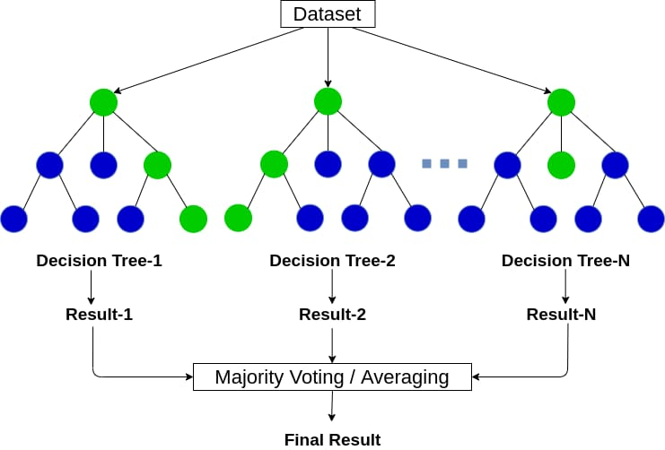
6. Algorithm used
Random Forest Algorithm.

Slide 9
7. Outcome of Project
Improved accuracy and reliability of flight price predictions.
Helped airlines optimize their revenue management strategies.
On the basis of Destination and Dates we get predicted prices of airline tickets.

Slide 10
8. Block Diagram
Home Page
Search Flight Ticket Prices
User Input
Predicted Prices

Slide 11
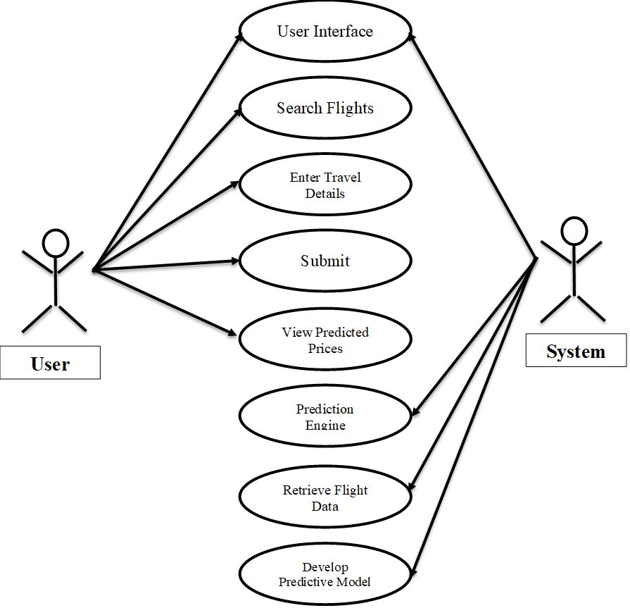
9. Use Case

Slide 12
10. Technology Stack
Language used:
    HTML
    CSS
    React Js

Slide 13
Thank You...!!

